Slide 2
Binghamton University
EngiNet™
State University of New York

Slide 3
Thomas J. Watson
School of Engineering and Applied Science

Slide 4
WARNING
All rights reserved. No part of the course materials used in the instruction of this course may be reproduced in any form or by any electronic or mechanical means, including the use of information storage and retrieval systems, without written approval from the copyright owner.
©2017 Binghamton University

Slide 5
CS580z/CS480z
(Fall. 2017)
(Tuesday’s and Thursday’s 11:40am to 1:05pm)
Introduction to the Mainframe: z/VM Basics
Lecture 2
August 29th, 2017
Faculty : Merwyn Jones
IBM z/VM Lab Development team
( http://www.vm.ibm.com/ )

Slide 6
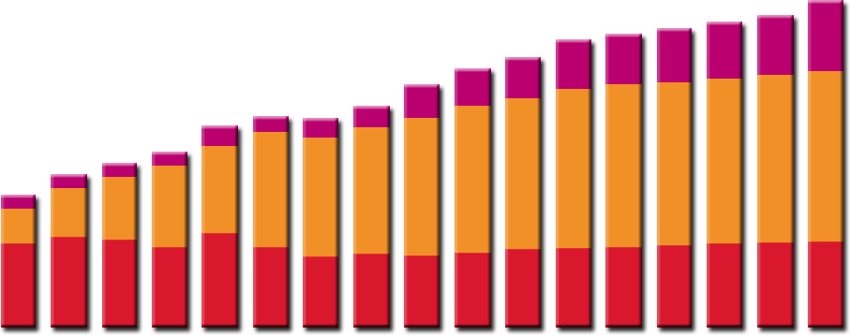
IT Budgets
Physical Server Installed Base (Millions)
Spending
US$ (B)
Worldwide IT Spending on Servers, Power, Cooling and Management Administration
$250
50
Power and cooling costs
Server mgmt and admin costs
New Server spending
45
$200
40
35
$150
30
25
$100
20
15
$50
10
5
$0
0
1996
1997
1998
1999
2000
2001
2002
2003
2004
2005
2006
2007
2008
2009
2010
2011
2012
Source: IDC

Slide 7
Factors contributing to mainframe use
  Capacity
  Scalability
  Integrity and Security
  Availability
  Access to large amounts of data
  Systems management
  Autonomic capabilities
Notes:
Reliability Involves the use of high-quality hardware and software components,
and extensive self-checking and self-recovery by hardware
components.
Availability The ability of hardware to detect and automatically replace failing
hardware elements, and for system software to detect, isolate, and
recover failing software components.
Serviceability Through well-defined units of replacement, the hardware and software
can often be non-disruptively serviced or upgraded, with little or no
impact to the operational system.
A secure computer system prevents users from accessing or changing any objects on the
system, including user data, except through system-provided interfaces that enforce
authority rules. Mainframe computers can provide a very secure system for processing
large numbers of heterogeneous applications that access critical data.
By scalability we mean the ability of the hardware, software, or a distributed system to
continue to function well as it is changed in size or volume; for example, the ability to
retain performance levels when adding processors, memory, and storage.
The need to support applications of varying ages imposes a strict compatibility demand
on mainframe hardware and software, which have been upgraded many times since the
first System/360 mainframe computer was shipped in 1964. Applications must continue
to work properly. Thus, much of the design work for new hardware and system software
revolves around this compatibility requirement.
Each new generation of mainframes has added improvements in one or more of the following
areas:
More and faster processors
More physical memory and greater memory addressing capability
Dynamic capabilities for upgrading both hardware and software
More sophisticated automated hardware error checking and recovery
Enhanced devices for input/output (I/O) and more and faster paths (channels)
between I/O devices and processors
Sophisticated I/O attachments, such as LAN adapters with extensive inboard
processing
Increased ability to divide the resources of one machine into multiple, logically
independent and isolated systems, each running its own operating system
Enhanced clustering technologies, such as Parallel Sysplex, and the ability to share
data among multiple systems.

Slide 8
Scalability Basics
Some definitions:
Hardware capability of a system to increase performance under an increased load when resources are added (From Wikipedia Encyclopedia http://en.wikipedia.org/wiki/Scalability)
Software ability to grow with your needs. A scalable software package means that you only buy the parts you need, and that it has the ability to grow by adding on as you grow. (From The Concise Tech Encyclopedia: http://www.tech-encyclopedia.com/term/scalability)
Scalability approaches
  Scale vertically or scale up : add resource to a single node in a system
  Scale horizontally or scale out : add nodes to a system
Notes:
Vertical scalability VS horizontal scalability

Slide 9
Scalability concepts
Provisioning
  Provisioning is the end-to-end capability to automatically deploy and dynamically optimize resources in response to business objectives in heterogeneous environments.
helps to respond to changing business
is a critical step to being able to then orchestrate the entire environment to respond to business needs on demand.
CoD encompasses the various capabilities for you to dynamically activate one or more resources in your server as your business peaks dictate.
Capacity Upgrade on Demand (CUoD), Customer Initiated Upgrade (CIU), On/Off Capacity on Demand
Notes:
Chong ability to bring up a Linux box every 7 seconds
Capacity on demand

Slide 10
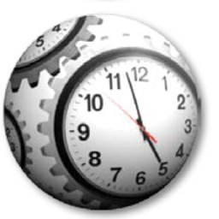
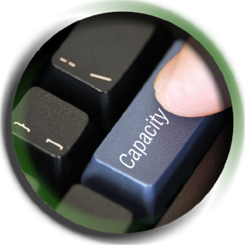
Just in time capacity gives you control
Permanent and temporary offerings – with you in charge
  Permanent offerings – Capacity Upgrade on Demand (CUoD), Customer Initiated Upgrade (CIU)
  Temporary offerings include On/Off Capacity on Demand (On/Off CoD) , Capacity Backup Upgrade (CBU) and a new one – Capacity for Planned Event (CPE)
No customer interaction with IBM at time of activation
  Broader customer ability to order temporary capacity
Multiple offerings can be in use simultaneously
  All offerings on Resource Link™
  Each offering independently managed and priced
Flexible offerings may be used to solve multiple situations
  Configurations based on real time circumstances
  Ability to dynamically move to any other entitled configuration
Offerings can be reconfigured or replenished dynamically
  Modification possible even if offering is currently active
  Some permanent upgrades permitted while temporary
  offerings are active
Policy based automation capabilities
  Using Capacity Provisioning Manager with z/OS 1.9
  Using scheduled operations via HMC
Notes:
Capacity Backup Upgrade (CBU)
Who Needs It?
Any business with a requirement for increased availability or Disaster Recovery
What Is It?
Provides the ability to nondisruptively increment capacity
temporarily, when capacity is lost elsewhere in the enterprise
Dual Microcode Loads
Provide two machine configurations in one box
Take advantage of "spare" PUs
Significant cost savings possible
Standby MIPS cost can be eliminated
IBM Software license charges on standby MIPS can be eliminated
Configure memory and channels to support production workload
How Can I Use It?
Adjacent machines in the same location
Multiple images in the same Parallel Sysplex® cluster
Backup/Recovery site
CBU
With IBM's Capacity Backup Upgrade (CBU), you have the support you need to rely on when you need emergency backups or disaster recovery. CBU enables alternative zSeries processors to take over workload from another server if an emergency should occur in another part of your establishment (same site – server failure, or different site). You can configure your system for CBU by reserving CPs on existing systems or planning for additional CPs when you are purchasing or upgrading a system. CBU is easy to implement and invoke when necessary.
GDPS can be configured to automatically invoke CBU on the secondary site during a takeover.
--------------------
(Alternative – stop Dev and Test LPARs to supply extra MIPS)

Slide 11

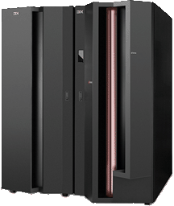
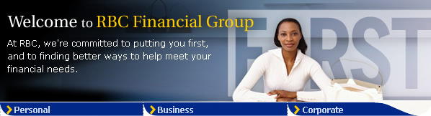
A real customer requirement:
Royal Bank Boosts Availability - Online Banking
IBM System z Parallel Sysplex System
Front End - Internet
WebSphere MQ
For z/OS, V5.3
Challenge: Maximize Availability
12 million customers
  2.5 million online
60,000 employees
Benefits
Reliable integration with internet
Supports ~40 web-based applications
Efficient use of parallel sysplex
Improved customer availability
Back End - Data/Applications
DB2 Database
IMS Database
CICS Applications
Notes:
Note to instructor: This is just an example for a typical Large System Customer and his requirements.
IBM will consolidate thousands of servers onto approximately 30 System z mainframes
We expect substantial savings in multiple dimensions: energy, software and system support costs
The consolidated environment will use 80% less energy and 85% floor space
This transformation is enabled by the System z’s sophisticated virtualization capability

Slide 12
Outage Definition
An outage (unavailability) is the time, a system is not available to an end user.
Outages may be planned or unexpected (unplanned). Planned outages include causes like data base reorganisation, release changes, and network reconfiguration. Unplanned outages are caused by some kind of a hardware, software or data problem
While planned outages can be scheduled, they still are disruptive. The modern trend is to try to avoid planned outages altogether. This requires extensive hardware and software facilities.
Notes:
Foil: Source: Spruth
Text Source: Redbook: GDPS info
Outage types
Back in the “good old days”, planned outages were relatively easy to schedule. Most of the users of your systems were within your company, so the impact to your system availability could be communicated to all users in advance of the outage. Examples of planned outages are software or hardware upgrades that require the system to be quiesced. These may take minutes or even hours.
Today, however, the bulk of the users of your system may not work for your company. Even if they do, they are probably spread out all over the world in your remote offices and the offices of your business partners. This means that the concept of a planned outage really no longer applies—the outage is not really planned if most of your users have no idea that their applications will be unavailable at a certain time. In the e-business world, planned outages can be just as disruptive to your users (and therefore your business) as unplanned outages.
Unplanned outages are unexpected events. Examples of unplanned outages are software or hardware failures. Software failures may be quickly recovered from, while hardware outages might be considered a disaster (for example, if you only have one CPC and that CPC fails). You will most likely encounter both planned and unplanned outages while running your organization. Your business resiliency processes must cater to both types. Later in this book we discuss the technologies available to you to make your organization more resilient to outages, and perhaps avoid them altogether.

Slide 13
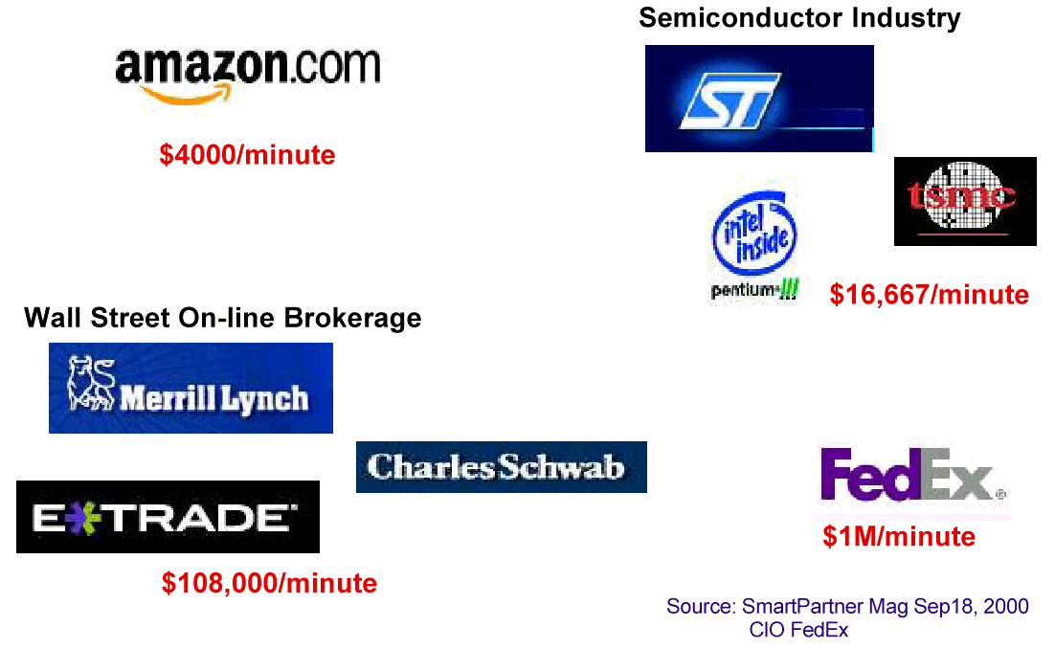
Cost of outages (examples)
Notes:
Cost of Downtime by Industry
Industry/Sector Revenue/Hour
Financial $8,213,470
Telecommunications $4,611,604
Information Technology $3,316,058
Insurance $2,582,382
Pharmaceuticals $2,058,710
Energy $1,468,798
Transportation $1,463,128
Banking $1,145,129
Chemicals $1,071,404
Consumer Products $989,795
Source: Robert Frances Group 2006

Slide 14
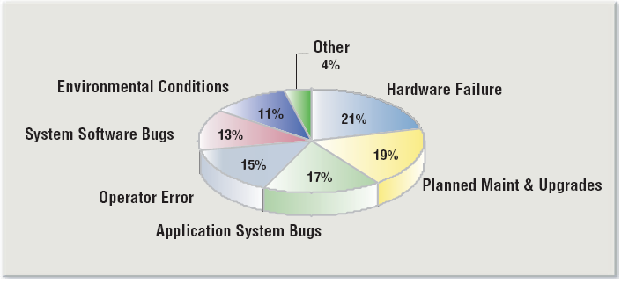
Types of Outages
Common Causes for “Application Downtime”
Source: Standish Group Research
Notes:
Source: IBM eServer zSeries: Premier Business Resiliency for the On Demand World, GM13-0638-00

Slide 15
Inhibitors to availability
Number of 9s – or the Myth of the nines
Class of 9s | Outage |  | Example
99,999 % | 5 min / year | Continous Availability | z/OS Parallel Sysplex
99,99 % | 53 min / year | Fault Tolerant | S/390 Parallel Sysplex
99,9 % | 8,8 hrs / year | High Availability | Single IBM System z CPC
99 % | 88 hrs / year | General Purpose | High available UNIX Cluster
90 % | 876 hrs / year |  | Campus LAN

Slide 16
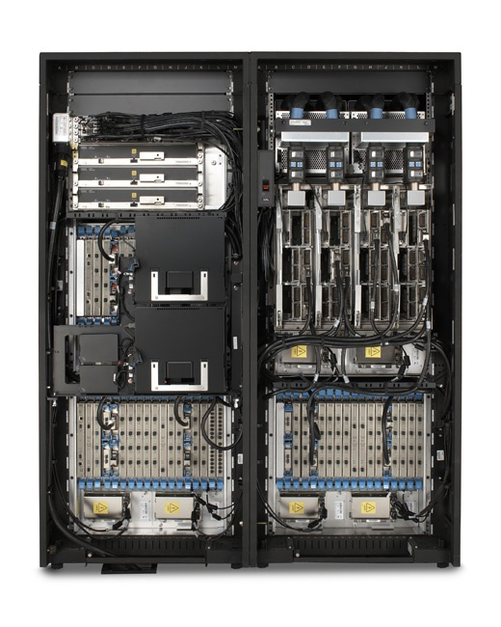


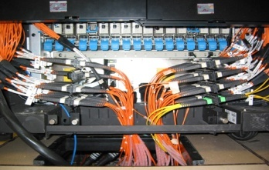
Under the covers
Hybrid Cooling
Air or air + liquid assisted cooling
Internal
Batteries
Processor Books
  16 PUs in each of 4 books
  CMOS 10K (90 nm) dual core microprocessors
  2 SAPs / book
  2 spares/ server
  1 - 54 PUs available
    CPs, IFLs, ICFs, zAAPs,
Memory
  (16GB to 512 GB)
  Chip Sparing
  ECC
Power Supplies: n+1
Dynamic oscillator switchover
3x I/O cages
  Total system I/O BW capability of 172.8 GB / sec
  Hot Pluggable I/O
CEC Cage
Fiber Quick Connect Feature
STI cables
Front View
Support Elements
-Concurrent Firmware Upgrades
Notes:
Theme: Mainframe hardware technology is leading edge from chips to System Packaging
Mainframes have shrunk to a space of only 2.49 sq. meters in the case of the z9 or z990 (they are the same) and 1.24 meters in the case of the single frame z890. The z890 is air cooled. The z990 and z9 utilize a closed loop liquid (R134A) cooling system augmented by air (heat sink on MCM). Although power and cooling are configuration dependent the mainframes low power design, shared everything architecture and advanced cooling technigology give it significant advantages in reducing power and cooling requirements. The amount of heat generated by mainframes ranges from a low of 5.12 – 62.4 kBTU (far less than the water cooled mainframes of 10 years ago). The power used ranges from 1.5 to 18.3 kVA. This is less than 1/10 of the old BiPolar mainframes or an HP Superdome. The maximum of the p595 is approximately 2X the z9-109 54W maximum configuration.
The Book package, introduced in 2003 with the z990, is a revolutionary “third” level of technology packaging that enables the critical resources for the central electronic complex (CEC) to be contained in a single Field Replaceable Unit (FRU). The Processor Book can be added or replaced on the fly for the new System z9 (replace on the fly assumes multibook configurations). A Customer can add processor, memory and I/O bandwidth by adding book package(s). This reduces the costs for scaling by having a modular design so mainframes do not have to be max configured but can grow in increments as need up to the maximum configuration. With the System z9 and new functions such as redundant I/O reconnect and flexible memory a Customer can confugure a system so in the rare event of a book failure the System can add resources and repath to provide sustained non degraded performance while maintenance is performed. Technology packaging levels: 1st = chip, 2nd = MCM or card, 3rd = Planer (system) Board and parts to make it a FRU
Word picture/ analogies:
1. A very fast multi engine plane can loose a engine in flight, and without reducing its speed, a miraculous engine replacement occurs while in the air (no landing necessary) and the plane arrives at its destination on time and with as much engine capacity as it started with. It can continue on its schedule without any cause for concern as it has the capacity it has been configured for and no disruptive maintenance is required.
A fast freight train has two to four engines. It has been configured to provide an average cruising traveling speed to count on reaching intermediate points along the journey on time as well as arriving at the final destination on time. If operating with two or more engines, in the rare event of an engine failure, the remaining engines will pick up the work of the failing engine with out any degradation in speed or capability. A repair miracle occurs and the failing engine is replaced with a new perfect engine and the new engine then picks up the work.
The Complementary Metal Oxide Semiconductor (CMOS) technology uses 90 nm lithography. CMOS 10k is the latest level of chip technology. The processor chip has approximately 121 Million transistors and is designed so that 1 or 2 microprocessors can be used. It is significantly smaller than the z990 PU. CMOS 10k enables a smaller chip and hence reduces the path length and power required. The glass ceramic MCM has been enhanced to include the capability to provide denser pathing than ever before between chips (there are 101 layers of wiring) as well as on and off the module using LAN GRID ARRAY technology for connection to the planer of the Processor book. z9 MultiChip Module (MCM) is the world’s densest logic package. If a demo z9 mcm is available this is the right time to pass it around the audience to “inspect”. If a chip technology card hand out is available pass one to each person in the audience. The MCM, which is almost the exact size of a diskette or a rectangular drink coaster, is the world’s densest logic package. IBM is the leader in not only dense chips but connecting them efficiently and reliably together. The MCM package enable performance while cooling chips to provide reliability. The z9 MCM has 104 Class Ceramic layers (3 more than the z990) and approximately .5 km of internal wiring. IBM uses the Glass Ceramic material as a substrate because of its superior low dielectric qualities. It enables signal propagation with very little cross talk, a very important characteristic for reliable dense electronic packaging.
A 2-GB/s enhanced self-timed interface (eSTI) was introduced which is capable of absorbing the ever-increasing data rates of modern
high-speed adapters. The I/O bandwidth available from a single node (three memory bus adapter, or MBA, chips, each with four eSTI ports) now equals 48 GB/s.

Slide 17
Reliability, Availability, and Serviceability (RAS).

Slide 18
Evolution of RAS for IBM System z high end Systems
 | z900 | z990 | z9 EC
Microcode Driver Updates | 6 Hr Scheduled outage | 6 Hr Scheduled outage | Concurrent*
Book Replacement** | Not Applicable | Scheduled Outage | Concurrent
Memory Replacement | Scheduled Outage | Scheduled Outage | Concurrent (Book Offline)
ECC on Memory Control Circuitry (EX: SMI) | Unscheduled Outage | Unscheduled Outage | Transparent
Memory Bus Adapter (MBA) Replacement | Scheduled Outage. Lose connectivity to I/O Domain | Scheduled Outage. Lose connectivity to I/O Domain | Concurrent. Connectivity to I/O Domain remains
STI Failure | As for MBA | As for MBA | As for MBA
Oscillator Failure | Unscheduled Outage | Unscheduled Outage | Transparent
Processor Upgrades | Concurrent | Concurrent | Concurrent
Physical Memory Upgrades | Scheduled Outage | Scheduled Outage | Concurrent (Book Offline)
I/O Upgrades | Concurrent | Concurrent | Concurrent
Spare PUs | 1 System | 2 / Book | 2 / System
*In select circumstances **Customer pre-planning required, may require acquisition of additional hardware resources
Notes:
Instructor Notes: Picture should explain, that there is a further evolution with every new Mainframe hardware to support more RAS features….

Slide 19
z9 EC Enhanced Book Availability
Book Add
  Model Upgrade by the addition of a single new book adding physical processors, memory, and I/O Connections
Continued Capacity with Fenced Book
  Make use of the LICCC defined resources of the fenced book to allocate physical resources on the operational books as possible
Book Repair
  Replacement of a defective book when that book had been previously fenced from the system during the last IML
Book Replacement
  Removal and replacement of a book for either repair or upgrade
Notes:
Just as an example, the following pages will show you, how a complete book can be removed, repaired and replaced again.
One thing I always thought was 'cool' about IBM iron was the PA facility.... the fact that it auto detects failures, calls home issues, etc. Sometimes a CE shows up with a replacement board before the customer even knows it had a problem.. etc. I always thought that was pretty cool... wasn't sure if it was appropriate with what you're presenting but thought I'd mention it.

Slide 20
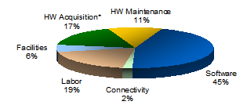
Client View of TCO Comparison for Similar Distributed Workload vs. Linux on z Systems Potential 60-75% Gross Costs Savings / 5 yrs
Operating Cost: Distributed vs. Enterprise Linux Server
IBM’s Datacenter Consolidation Effort*
Labor
Unit | Distributed | Enterprise Linux Servers | % Reduction
Software Licenses | 26,700 | 1,800 | 93%
Network Connections VIOS, Admin, Backbone, storage | 31,300 | 960 | 97%
Cables | 19,500 | 700 | 96%
Power Kilowatt Hours | 38,400 | 7,673 | 80%
Floorspace | 687,000 | 103,000 | 85%
Connectivity
Software
Relative Cost
HW Maintenance
HW Acquisition
Facilities
Distributed Cost
Enterprise Linux Server Cost
Potential Savings: Categories as a
% of Gross Savings
HW Acquisition*
17%
HW Maintenance
11%
Facilities
6%
Labor
19%
Software
45%
*This is IBM’s internal consolidation effort to reduce overall data center footprint . Currently a reduction of over 10,000 servers since 2008
\ Results for client implementations may vary based on several factors including # of servers and workload types
Operating Cost and Potential Savings charts display a client View TCO comparison for Distributed Workload vs. ELS in a 3000+ system solution that represent a potential 60-75% Gross Costs Savings over 5 yrs.
*HW Acquisition compares server/disk refresh of distributed environment to the cost of acquiring new ELS/storage
© 2015 IBM Corporation
Notes:
This was created using data from an IBM tool called Race using IBM historical usage from hundreds of implementations to generate an estimated IFL requirement for the environment
Asks for each one of the items (acquisition, maintenance, facilities, labor, connectivity, and software)
The Percentage example above makes the following assumptions of Unix systems
Pulled from maintenance tables and averaged across 3,000 systems
5+ years old systems, depreciation complete, replacement value included
Assumed SQFT for a standalone system, racks and SSA
Cores on each system (4 core systems)
Number of licenses on this system for DB2
Assumed 2 Network ports per system
Labor numbers calculated based on IBM system experience of number of supported systems for ELS is 5 times greater than in x86

Slide 21
Blue Cross Blue Shield of Minnesota
Reducing TCO with virtualized Linux on System z
Business Challenge:
The Microsoft® Windows® and Intel® processor-based server landscape at Blue Cross and Blue Shield of Minnesota (BCBSM) was inflexible and costly to operate and maintain.
Solution:
IBM helped BCBSM consolidate 140 servers to a single
IBM System z® with six Integrated Facility for Linux® (IFL) engines. Key applications now run in Linux virtual servers, while IBM DB2® databases run on z/OS® on the same physical machine.
“From every perspective, running applications under Linux on System z makes sense for our organization. Performance, reliability, disaster recovery, server provisioning and cost efficiency have all seen dramatic improvements—helping BCBSM deliver better service and better value to its members across the state.”
— Ted Mansk, Director of Infrastructure Engineering and Databases at BCBSM
Benefits:
Significant TCO reduction over five years
Virtualization cuts server provisioning times by 99 percent
Disaster recovery can be achieved 97 percent faster than before
Solution Components
IBM System z9® EC
IBM System z10™ EC
© 2015 IBM Corporation

Slide 22
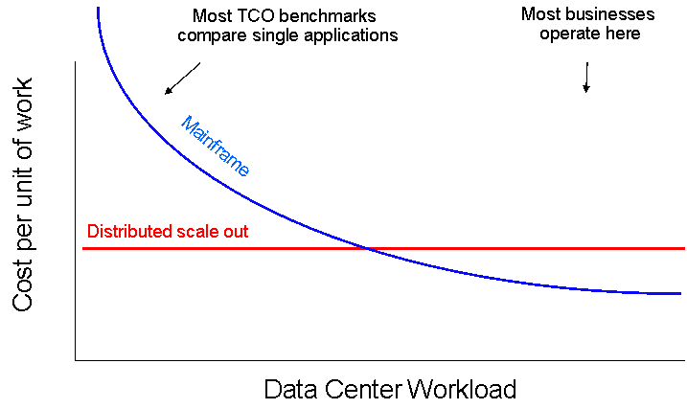
Smarter Virtualization
For Cost Savings and Operational Efficiencies
A fundamental strength of z Systems is its ability to share system resources to an extreme level
z Systems can share all hardware assets with very high levels of resource utilization and virtualization efficiency
  Both real and virtual resources can be shared with very high levels of bandwidth and reliability for enhanced workload throughput
© 2015 IBM Corporation

